Slide 1
Welcome To York Code Dojo
David Betteridge
Yorkdevelopers.org
@yorkdevelopers
@yorkcodedojo

Slide 2
Agenda
Quick Introduction
Explain the problem
Work in pairs till 8.45pm
Opportunity to show off solutions
Pub about 9pm

Slide 3
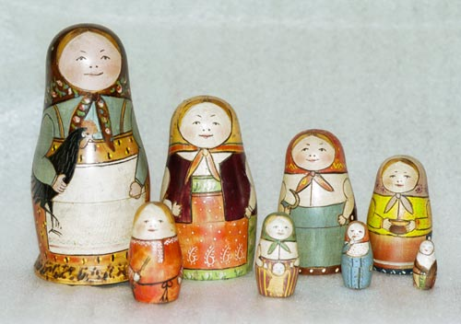
Recursion
Notes:
The dolls get smaller and smaller…

Slide 4
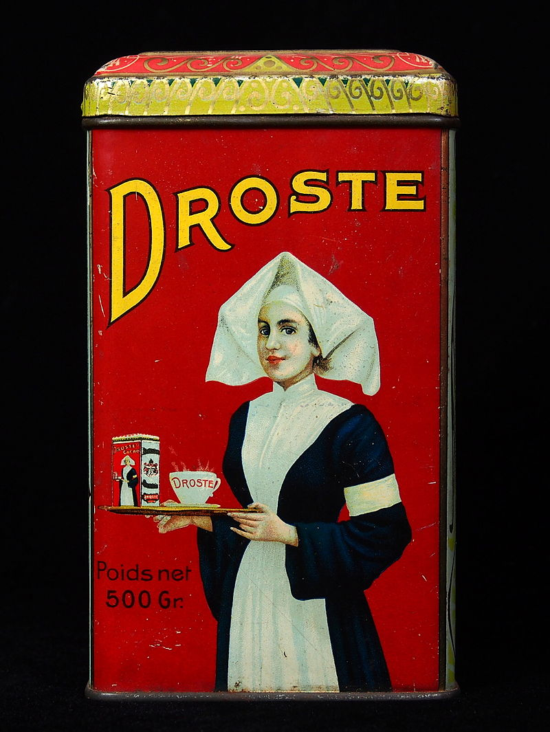
Notes:
In order to draw the picture you first to draw the picture

Slide 5
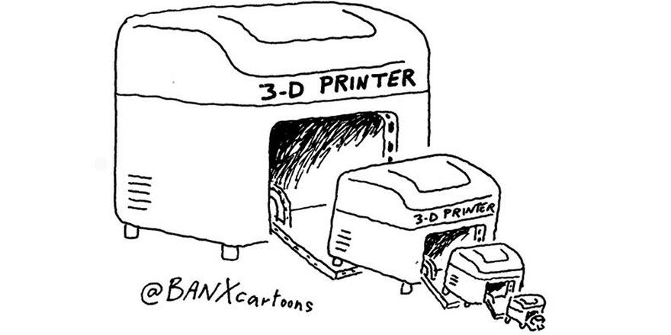
Notes:
You need to print a 3d printer in order to print a 3d printer

Slide 6
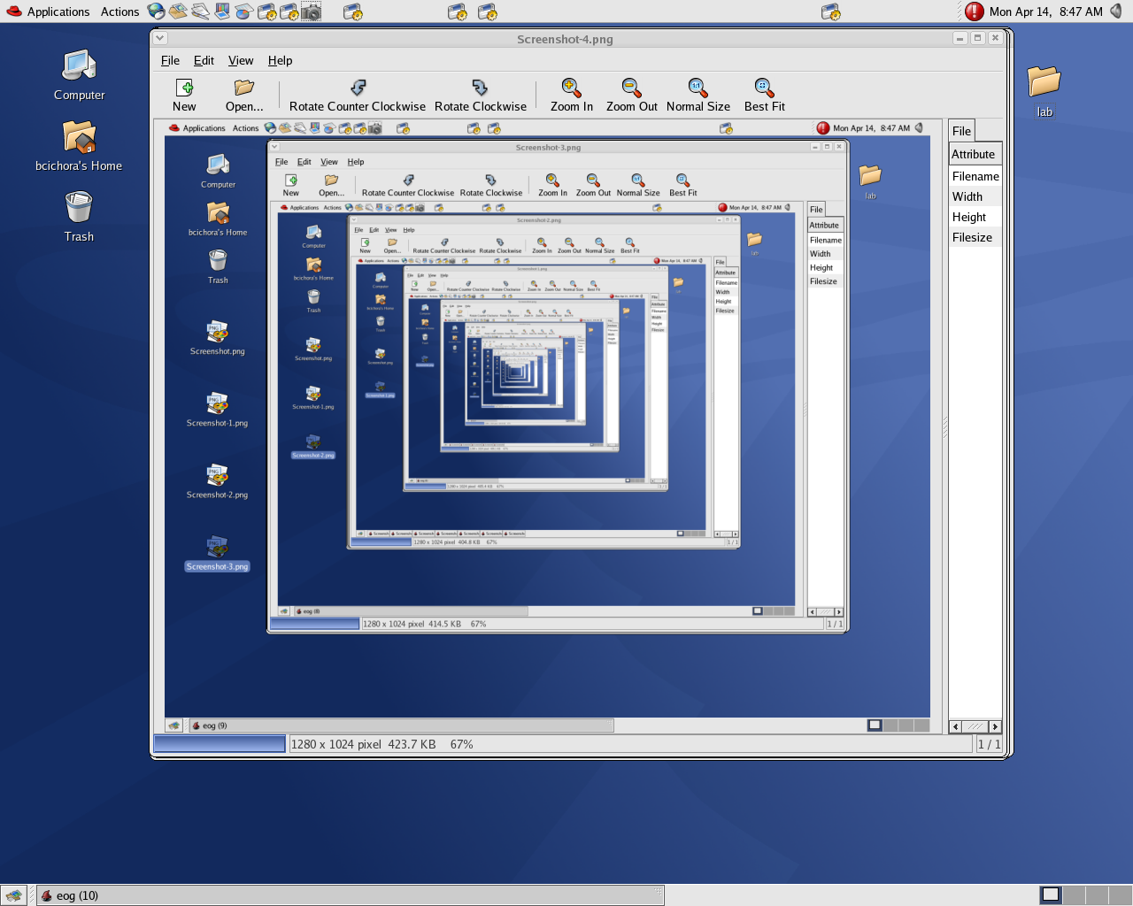
Notes:
You have to know when to drop – ie a base case

Slide 7
Technique
Base Case
Work Towards The Base Case
Tail Call Optimisation
Continuations

Slide 8

Example - Factorial
4 * 3 * 2 * 1 = 24
Notes:
How many ways can you arrange these coloured dots?
Position One – 4
Position Two – 3
Position Three – 2
Position Four – 1
4 * 3 * 2 * 1 = 24
Base case – how many ways can you have 1 item? - 1
How many ways can you have 0 items? 0
So 0! = 1
And 1! = 1
What happens if you don’t have a base case? - It keeps calling itself. Everytime it calls itself it put the details of the calling function on the stack so that it can unwind itself.
static int factorial(int n)
{
if (n == 0)
{
return 1;
}
else
{
return n * factorial(n - 1);
}
}
static void Main(string[] args)
{
Console.WriteLine(factorial(4));
}

Slide 9
Tall Call Optimization (TCO)
return n * factorial(n - 1);
Notes:
The problem here is that after calling factorial, when need to remember and multiple it by the previous return N
If we didn’t do this, then we would need to keep the details of the previous call on the stack.
Instead we re-write the function to take an accumulator.
Add parameter
Return acc
factorial(n - 1, n * acc);
Initialise to 1
Not all languages support it. F# does. C# 64bit can. Latest JS does (i think)

Slide 10
The Rules
Avoid Loops
Avoid Mutation of variables

Slide 11
York Developers
Games Developers (Last Thursday of the month)
Code and Coffee (Monday and Wednesday mornings)
Agile York (3rd Wednesday of the month)
Internet of things

